Slide 1


How to Talk to Your Legislators
North American Interdistrict Meeting 6/26/21

Slide 2
Bobbee Cardillo
Zonta USA Caucus Co-Convener bobbeelcardillo@gmail.com

Slide 3
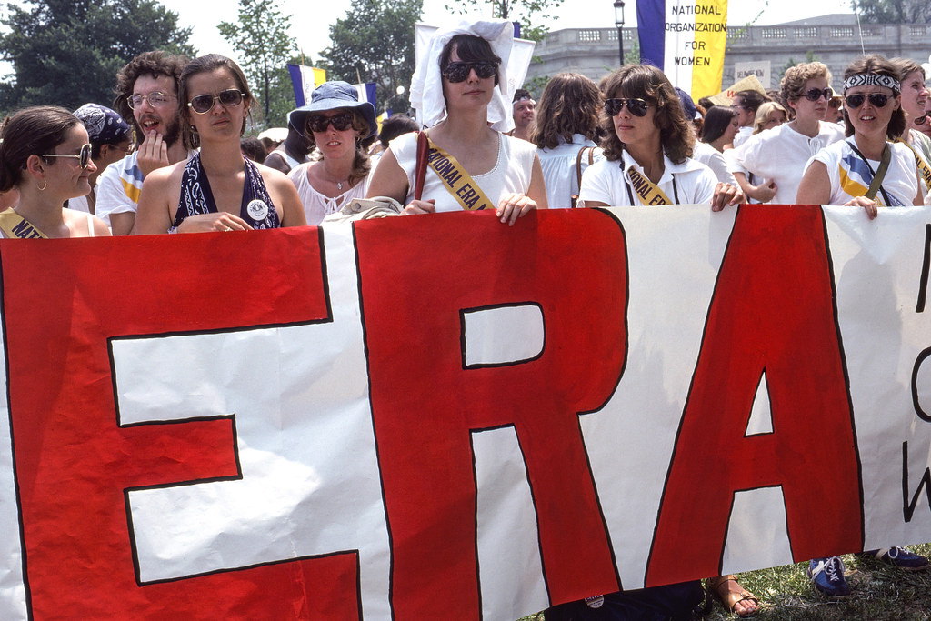
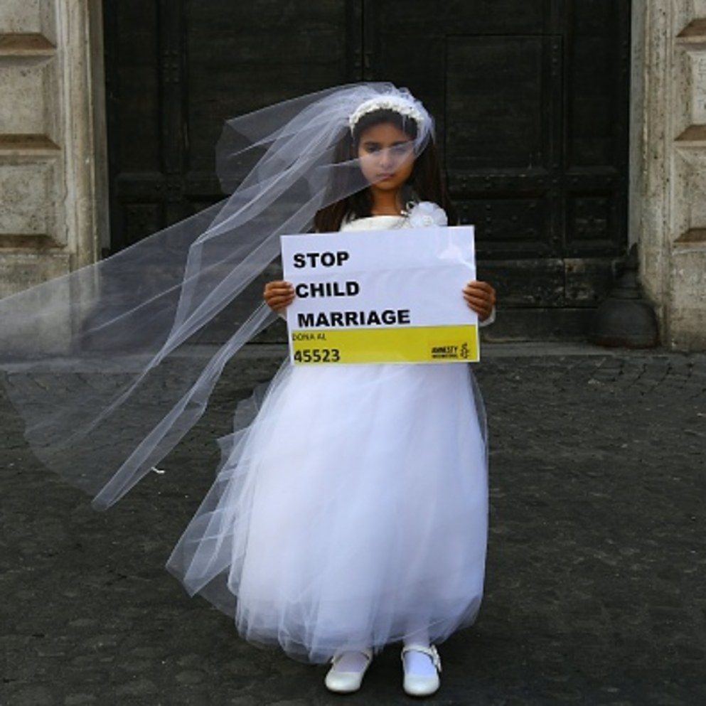
Legislative Advocacy—Process
Plan and Prepare
  What is your issue?
  Who is your Target
    Federal, State or Local official?
    Who do you need to speak to?
    What is their position on the issue?
  How
    Meet In person or virtually?
COMMITTEE INFORMATION
DISCLOSURES
ABOUT THE CLERK

Slide 4
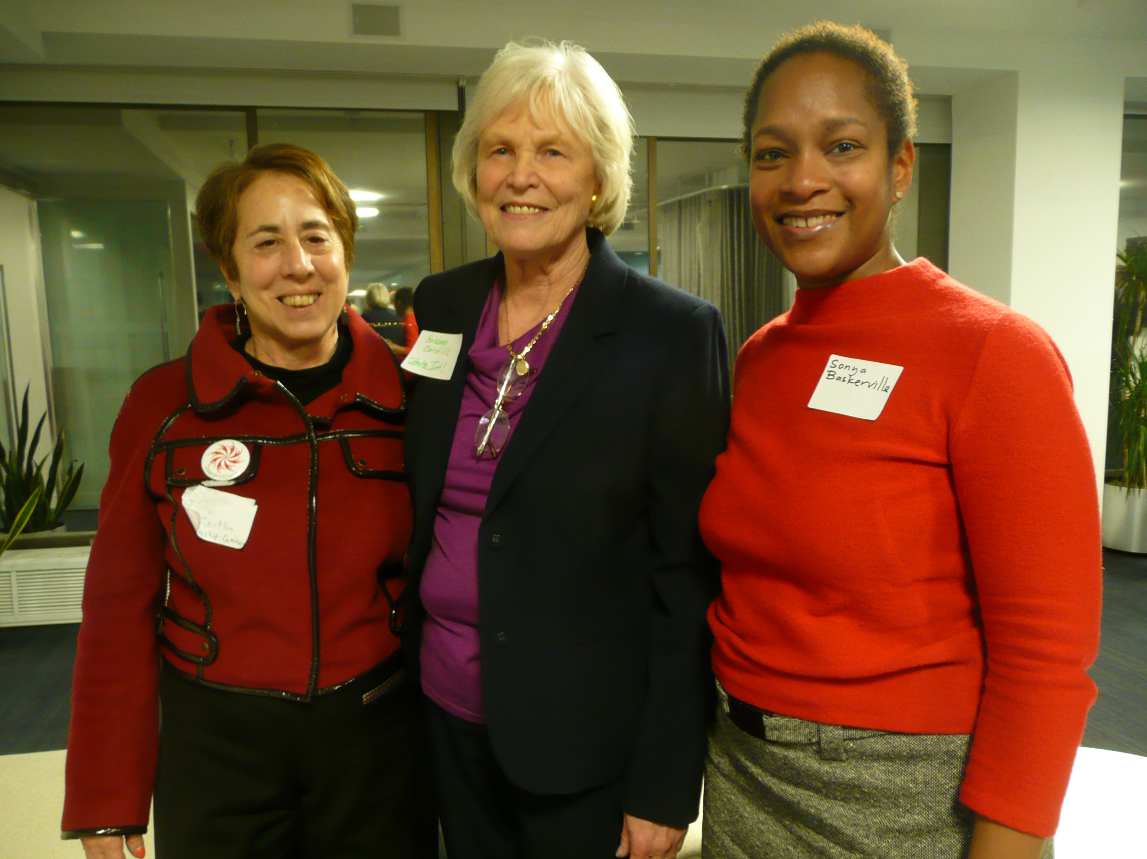
Process continued…
    Who?
      Committee? Club? Delegation?
      Constituent? Harmed party (ie survivor)? Partner organization?
    Where?
      Capitol Hill or home district?
      State Capitol or local office?

Slide 5
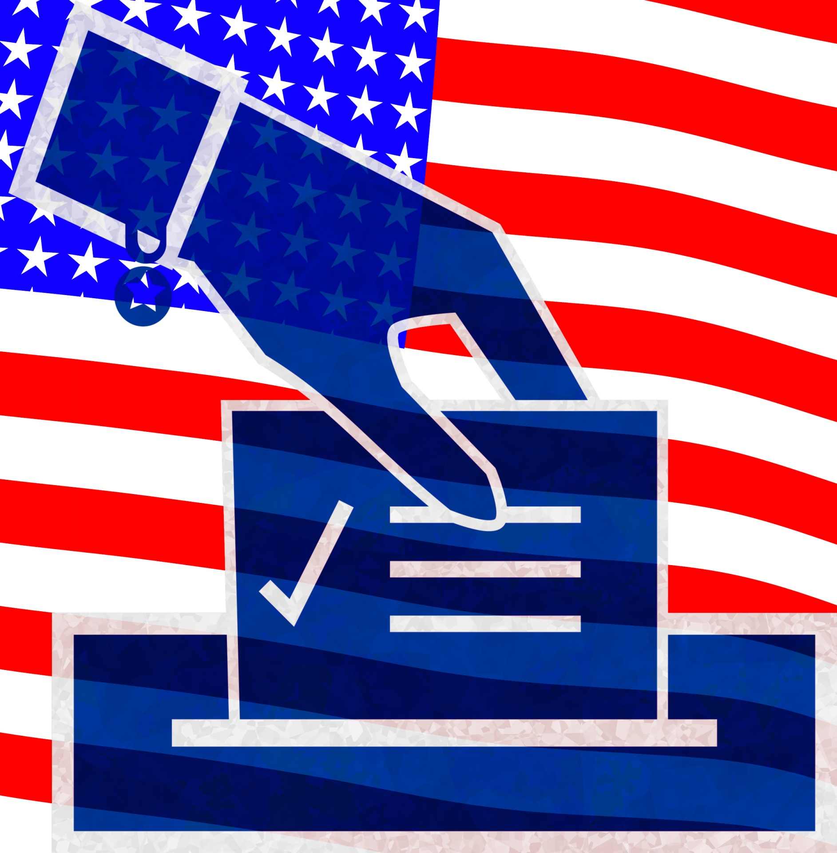
Process continued….
  EXECUTE
    Talking to your Legislator
  Evaluate
    Legislator’s Vote on Bill
    Did Bill pass?
  Report
    Club
    District Advocacy Chair – Area Director
    Zonta International – “Share Your Story”
      https://www.zonta.org/ShareYourStory

Slide 6
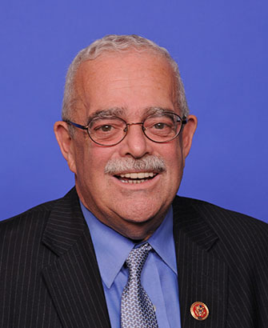
Know Your Legislator
Federal Level
ie, My street, Virginia:
Rep Gerry Connolly
  Check on www.congress.gov
    FIND YOUR REPRESENTATIVE
    MEMBER PROFILE
      Overview & Contact
      Committees & Subcommittees
      Recent Votes
      Congress.gov Profile
      Biographical Directory Profil
  Or www.govtrack.us

Slide 7
Know your Issue
CHILD MARRIAGE –HR 1606
ERA – SJ Res 1
End Forced Child Marriages Act
Introduced in House 3/8/21
Requires the Dept of Health and Human Services to study & report on state laws regarding the minimum marriage age and the prevalence of marriage involving a child who is under the minimum marriage age.
Study to be available within one year of passage of the bill.

Slide 8
Do Your Homework
How has your legislator voted on your issue in the past?
Check out VoteSmart
  https://justfacts.votesmart.org/candidate/key-votes/95078/gerry-connolly/68/women
Does he already support the bill you are advocating for? Or has he supported others similar?
    Example: End Forced Child Marriages Act, HR 1606—See https://www.congress.gov/bill/117th-congress/house-bill/1606/cosponsors?r=1

Slide 9

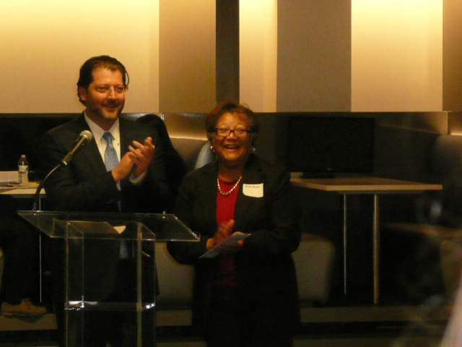
Legislator’s Position
Responses to your letters
Voting Record
Removing the deadline for the ratification of the Equal Rights Amendment
Co-sponsor 11/8/19
Removing the deadline for the ratification of the Equal Rights Amendment
Yes 2/13/20
April 9, 2021
Ms. Bobbee Cardillo
13045 Harvest Pl
Clifton, VA 20124-0948
Dear Ms. Cardillo,
Thank you for contacting me with respect to early childhood care and learning. I appreciate your interest in this issue, and your views are important to me.
I have consistently supported funding for Child Care and Development Block Grant program, which is a vital service for working parents in our community. I will continue to closely monitor the committee's progress, and I look forward to supporting the program again throughout the Appropriations process and when it is presented to the full House for consideration.
Once again, thank you for expressing your concern on this important issue. I appreciate hearing from you. For more information on my views on other issues, please feel free to visit my website at http://connolly.house.gov. I also encourage you to visit the website to sign up for my e-newsletter.
Sincerely,
Gerry Connolly
Member of CongressGC/JG

Slide 10
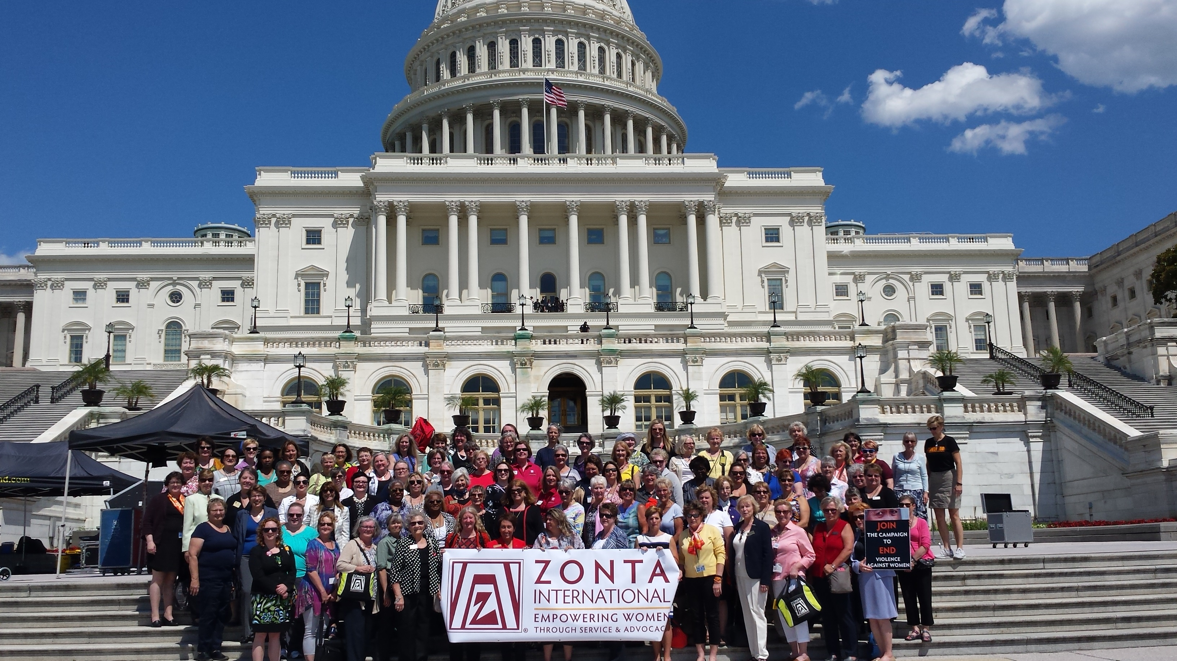
Want to Meet on Capitol Hill?

Slide 11
Requesting a Visit
You MUST be a constituent or someone requesting an appt on behalf of a constituent. If calling as a Zonta member, mention your club’s location and say how many constituents will attend.
Have a clear agenda: Just one issue or a couple of specific bills related to that issue.
Either: Call the office and request the scheduler’s email or
  Fill out a request for meeting online and follow up with call to office
  Ask for the scheduler /say why you want the meeting and ask whom you should to talk or email.
Follow-up, follow-up, follow-up

Slide 12
Getting Ready for the Visit
What committee is the bill referred to? Is your legislator on that committee?
Understand arguments for and against the issue or the bill
Have talking points. Be prepared to share them in a leave-behind package that also contains information on Zonta
Plan for 15 minute presentation
Decide who is going to present which part of it

Slide 13
Getting Ready continued…
Try to have a personal story told by someone who would benefit from passing this legislation
HAVE A CLEAR ASK! Do you want legislator to vote for or against? Co-sponsor the bill? Sign a pledge? Lobby fellow legislators.

Slide 14
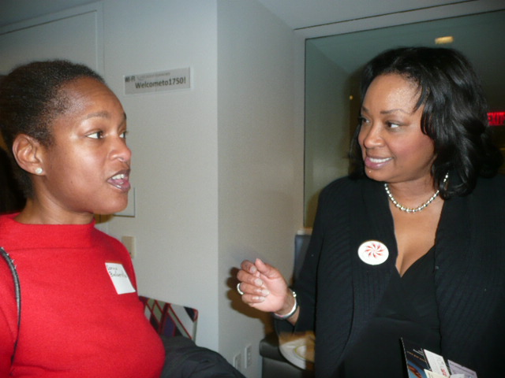

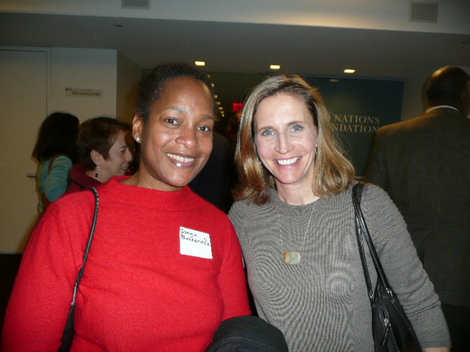
Execution
Thanks legislator or staff person
Identify your group and members
Present your case
Make the Ask!
Take questions. If don’t know the answer
  promise to get back to them
Ask for photo
Write follow-up Thank You

Slide 15
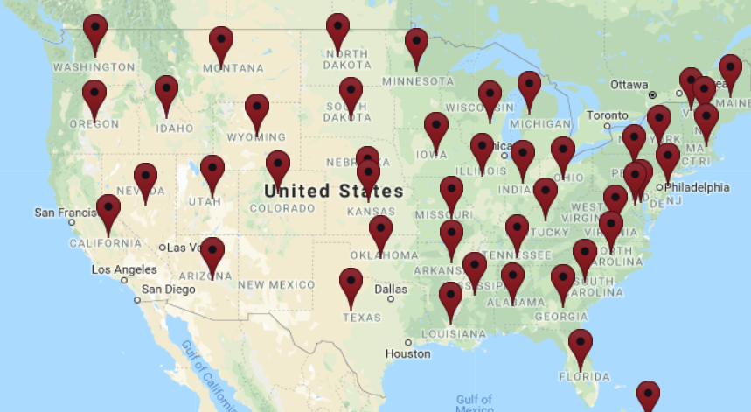
Membership
Members:
Representatives from each of 13 districts with clubs in the USA, (D1-12 and D15) appointed by the Governor, who participate and vote on behalf of their district during the biennium. They keep Governors informed and secure approval for votes undertaken by the Caucus.
Alternates, appointed at Governor’s discretion, who also participate in subcommittees and discussions and may vote for their district if Caucus member is absent.
Governors of the 13 districts are always welcome. They may participate in discussions and on subcommittees if desired. They approve votes.

Slide 16
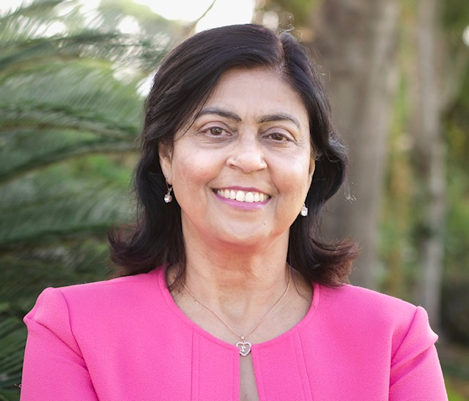
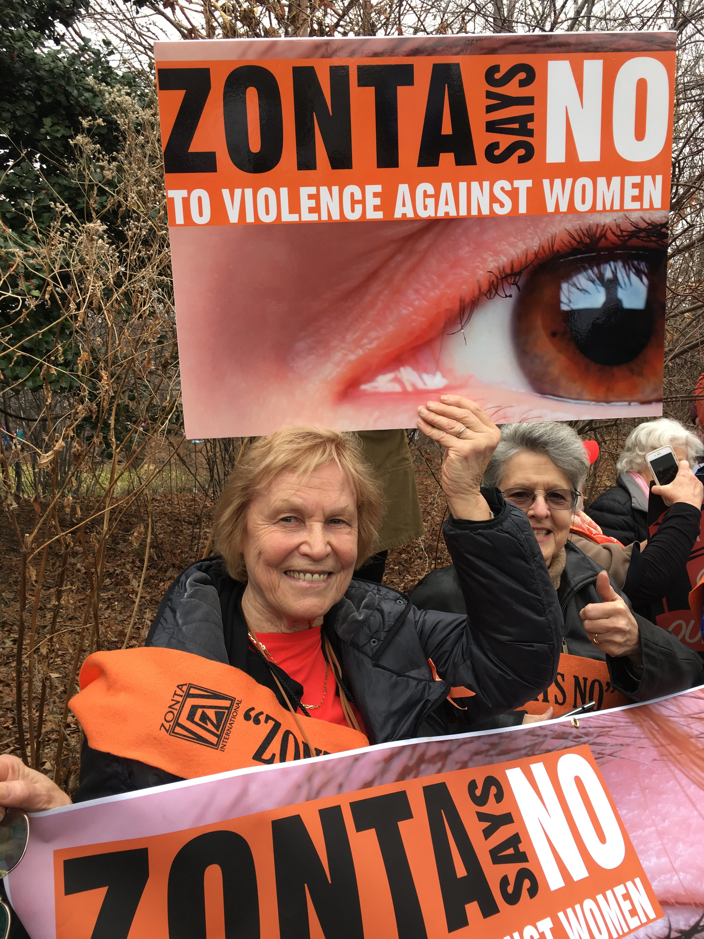
Leadership
Leaders:
Co-Conveners 2020-22:
Members of the Zonta International Advocacy Committee who represent the United States are ex-officio members of the Caucus.
They convene meetings under the authority of the ZI Advocacy Committee Chairman and ZI President, with input and support from HQ staff.
Ela Pandya
Bobbee Cardillo

Slide 17

USA Caucus Goals
Encourage development, consideration and passage of appropriate legislation by
  the US Congress, its members and committees and
  by state legislatures.
Take action in support of, or in opposition to, proposed or enacted legislation and executive orders and regulations that directly or indirectly impact the lives of women and girls.
Promote women’s representation in decision-making positions on an equal basis with men.

Slide 18

USA Caucus Top Issues for 2020-2022
Ending Child Marriage
Equal Rights Amendment
Zonta Says No
  VAW, Domestic violence, Trafficking
Women’s Work
  Equal Pay, Women on Boards, EEOC
Education
  STEM, Title IX
Health
  FGM, Impact of Covid 19

Slide 19
State Level Advocacy
State Bills
State Alerts
Model Legislation
Advocacy Day meeting suggestions
Caucus Members and Alternates
  Work with advocacy chairmen in each district to plan and implement advocacy actions at the State level,
  potentially including model legislation and scripted advocacy day meeting suggestions.
The USA Advocacy Action Center
  can be used for Alerts on STATE legislation as identified by each district (Advocacy Chair and Caucus Member)

Slide 20
Zonta USA Action Center Emails
Hi Bobbee in Clifton, VA!
Promote use of trauma-informed techniques in responding to sexual assault crimes
In the United States, one out of every six women has been the victim of an attempted or completed rape in her lifetime. In the two weeks following the assault, 94% of women experience symptoms of post-traumatic stress disorder (PTSD). Approximately 70% of rape or sexual assault victims experience moderate to severe distress, a larger percentage than for any other violent crime.
The Abby Honold Act seeks to promote the use of trauma-informed techniques by law enforcement when responding to sexual assault crimes. It is inspired by Abby Honold, a former student of the University of Minnesota who was violently raped in 2014.
urge your members of Congress to co-sponsor and support S. 119 and H.R. 649.
urge your members of Congress to co-sponsor and support S. 119 and H.R. 649.
This bipartisan legislation was reintroduced by Sen. Amy Klobuchar (D-MN) in the Senate on January 28 and by Rep. Tom Emmer (D-MN-6) in the House of Representatives on February 1. Please use our pre-drafted letters to urge your members of Congress to co-sponsor and support S. 119 and H.R. 649. If they have already sponsored or co-sponsored the bill, you can send a pre-drafted message of thanks.
urge your members of Congress to co-sponsor and support S. 119 and H.R. 649.
This bipartisan legislation was reintroduced by Sen. Amy Klobuchar (D-MN) in the Senate on January 28 and by Rep. Tom Emmer (D-MN-6) in the House of Representatives on February 1. Please use our pre-drafted letters to urge your members of Congress to co-sponsor and support S. 119 and H.R. 649. If they have already sponsored or co-sponsored the bill, you can send a pre-drafted message of thanks.
This bipartisan legislation was reintroduced by Sen. Amy Klobuchar (D-MN) in the Senate on January 28 and by Rep. Tom Emmer (D-MN-6) in the House of Representatives on February 1. Please use our pre-drafted letters to urge your members of Congress to co-sponsor and support S. 119 and H.R. 649. If they have already sponsored or co-sponsored the bill, you can send a pre-drafted message of thanks.
This bipartisan legislation was reintroduced by Sen. Amy Klobuchar (D-MN) in the Senate on January 28 and by Rep. Tom Emmer (D-MN-6) in the House of Representatives on February 1. Please use our pre-drafted letters to urge your members of Congress to co-sponsor and support S. 119 and H.R. 649. If they have already sponsored or co-sponsored the bill, you can send a pre-drafted message of thanks.
This bipartisan legislation was reintroduced by Sen. Amy Klobuchar (D-MN) in the Senate on January 28 and by Rep. Tom Emmer (D-MN-6) in the House of Representatives on February 1. Please use our pre-drafted letters to urge your members of Congress to co-sponsor and support S. 119 and H.R. 649. If they have already sponsored or co-sponsored the bill, you can send a pre-drafted message of thanks.….
Zontian
Title IX
Urgent Issues
Direct action by Zontians
  Advocacy
  Comments
  Sign Letters
Can be forwarded and subscribed by non-Zontians
https://www.votervoice.net/Zonta/home

Slide 21
USA Caucus Actions to Date 2020-2021
Action Alerts
Participation in US Women’s Caucus at UN, ERA Coalition, National Coalition to End Child Marriage
End Child Marriage (CM) billboard campaign with Unicef USA
Active participation in Coalition to End CM in MI, HI, NH, NY
  Letter writing, testifying, statements
Active participation in letter writing to Congress and President Biden, Letters to the Editor and testimony for ERA
Issued Statements on Racism, Capitol Hill Violence, 1st Female VP and Women in Congress
Plan to create a council of experts on subject matters pertinent to Zonta’s mission
Working on alliance with AHA Foundation to work against FGM
Exploring major health issues for women, ie PP Depression
Plan to join Paycheck Fairness Act Coalition

Slide 22
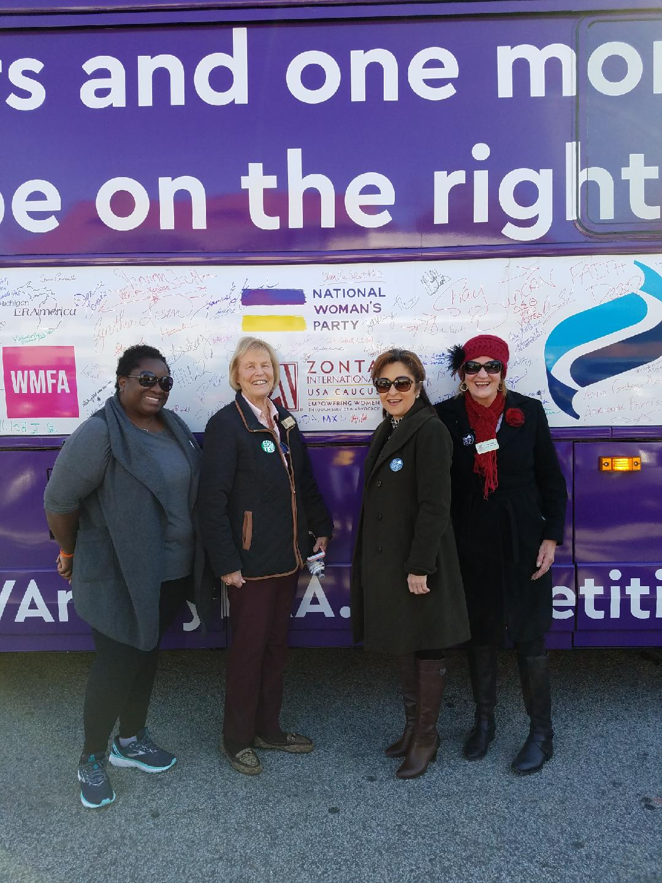
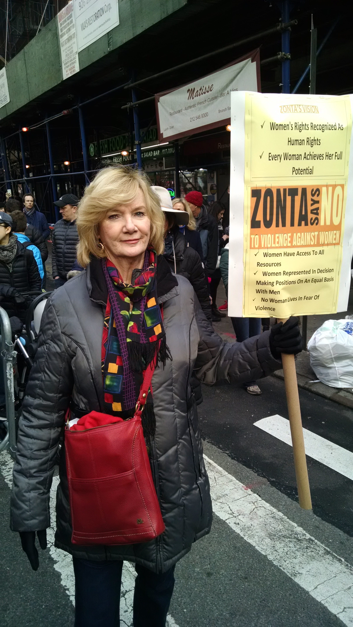
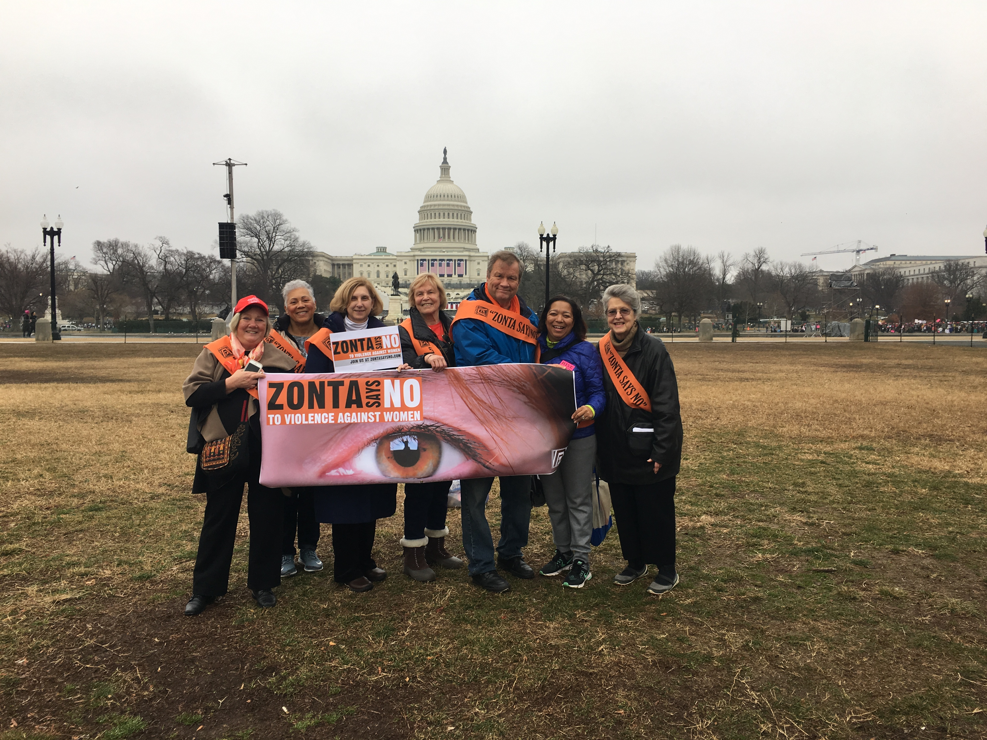
www.zontausa.org

